Slide 1




Using novel remote electronic monitoring to measure and manage the Rheumatology Clinic backlog generated by COVID-19
Dr. Dominik Kurzeja
BA, BM BCh
dominik.kurzeja@doctors.org.uk
@domashwin
Notes:
Analyse the size and management of the outpatient backlog gernrated by covid 19

Slide 2





Using novel remote electronic monitoring to measure and manage the
Rheumatology Clinic backlog generated by COVID-19
.
Scan the QR Code for more detail!
Dominik Kurzeja¹, Anushka Soni², John Jackman², Joel David², Raashid Luqmani²
¹Internal Medicine, Oxford University Hospitals, Oxford, UNITED KINGDOM, ²Rheumatology, Nuffield Orthopaedic Centre, Oxford, UNITED KINGDOM
BACKGROUND
During the COVID-19 pandemic we were unable to provide regular outpatient services.
A backlog of 6812 patients without an allocated follow-up appointment accrued by September 2021.
We aimed to analyse attempts to deliver care remotely to patients on the backlog using:
Video appointments
Telephone Appointments
Electronic remote management forms (RMFs).
METHODOLOGY
We focussed on the 3259 patients whose last appointment was between May 2020 and May 2021.
We re-looked at this portion of the backlog on four occasions between September ‘21 and September ’22 to assess how many still remained to be seen: at baseline, then at 1, 2, 6 and 12-months
Sep 2021
Oct 2021
Nov 2021
Mar 2022
Sep 2022
1
2
3
4
5
Audit Time Points

Slide 3
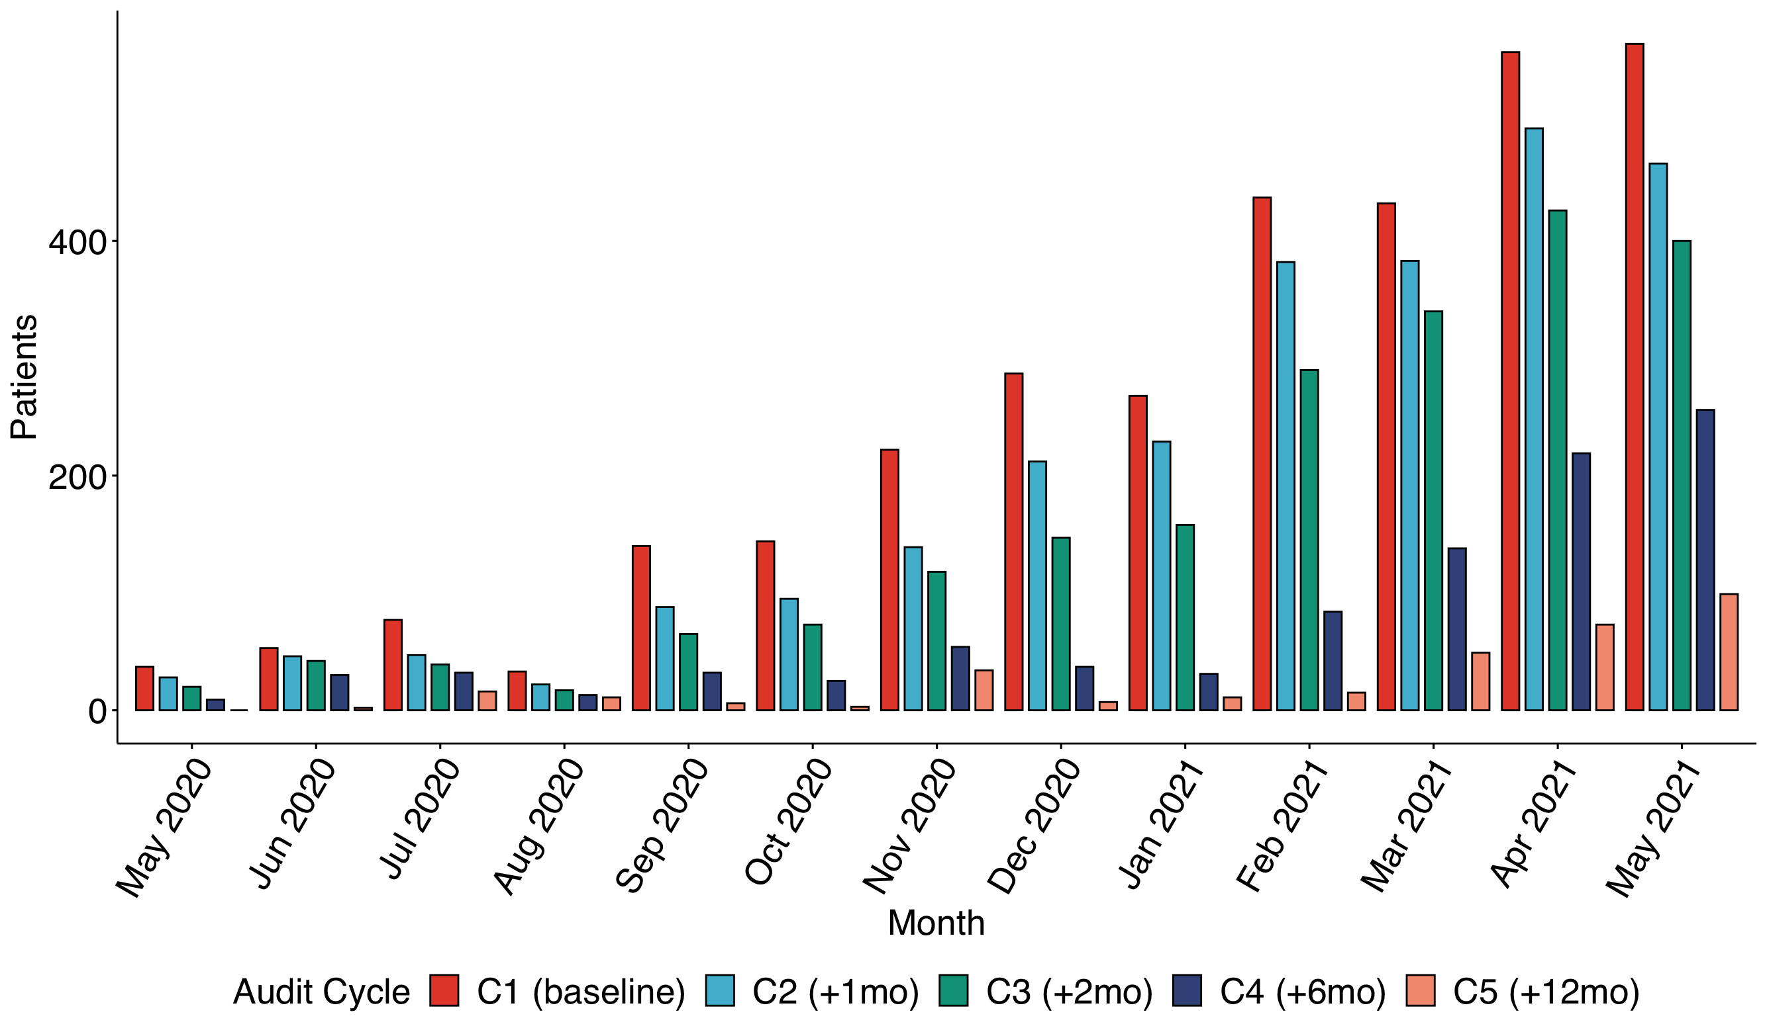
Using novel remote electronic monitoring to measure and manage the
Rheumatology Clinic backlog generated by COVID-19
.
Scan the QR Code for more detail!
Dominik Kurzeja¹, Anushka Soni², John Jackman², Joel David², Raashid Luqmani²
¹Internal Medicine, Oxford University Hospitals, Oxford, UNITED KINGDOM, ²Rheumatology, Nuffield Orthopaedic Centre, Oxford, UNITED KINGDOM
RESULTS
Remote Management Forms
1956 forms were completed between September 2021 & March 2022.
Only 261 patients recorded prior appointment date.
154/261 (59%) were completed by patients on the backlog between May ‘20 – May '21, indicating a preferential use of RMFs targeting backlog patients.
5% of all backlog patients were managed with RMFs (based on available data).
Months from Baseline | Cumulative pts seen (%) | Cumulative assessed by RMF (%)
+1 | 626 (19) | 17 (2.72)
+2 | 1124 (34) | 60 (5.3)
+6 | 2299 (71) | 154 (6.7)
+12 | 2933 (90) | 154 (5.2)
We demonstrate a 90% reduction in patients awaiting follow-up since these dates (within 12 months (from 3259 to 326).
A 71% reduction was achieved by 6 months (March 2022).
This reduction was statistically significant and progressive (p<0.001 - Chi-square test for trend).

Slide 4
Using novel remote electronic monitoring to measure and manage the
Rheumatology Clinic backlog generated by COVID-19
.
Scan the QR Code for more detail!
Dominik Kurzeja¹, Anushka Soni², John Jackman², Joel David², Raashid Luqmani²
¹Internal Medicine, Oxford University Hospitals, Oxford, UNITED KINGDOM, ²Rheumatology, Nuffield Orthopaedic Centre, Oxford, UNITED KINGDOM
CONCLUSION
We have significantly reduced the size of our backlog of outpatient follow-up due to COVID-19 over a 12-month period with a sizable contribution from remote management.
1
2
3
We demonstrate a 90% reduction in the number of patients with unallocated follow up since the pandemic period within 12 months
Remote management made a sizeable contribution, meaning some of this reduction was achieved without clinician-patient encounters; these results underestimate the effect of RMFs due to this dataset being incomplete
We show robust integration of our RMFs into outpatient services, providing evidence for remote management as a useful tool in outpatient care e.g. in areas such as patient-initiated follow-up pathways.
References:
Annals of the Rheumatic Diseases 2021;80:289-290.

